Slide 1
Automata Theory +Compiler Design=ACD
Reading: Chapter 1
Mathematical Preliminaries and Notation

Slide 2
What is Automata Theory?
Study of abstract computing devices, or “machines”
Automaton = an abstract computing device
Note: A “device” need not even be a physical hardware!
A fundamental question in computer science:
Find out what different models of machines can do and cannot do
The theory of computation
Computability vs. Complexity

Slide 3
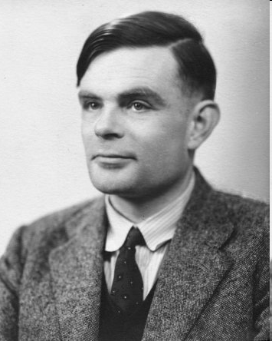
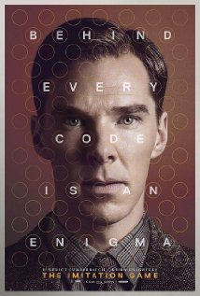
Alan Turing (1912-1954)
(A pioneer of automata theory)
Father of Modern Computer Science
English mathematician
Studied abstract machines called Turing machines even before computers existed
Heard of the Turing test?

Slide 4
Theory of Computation: A Historical Perspective
1930s
Alan Turing studies Turing machines
Decidability
Halting problem
1940-1950s
“Finite automata” machines studied
Noam Chomsky proposes the “Chomsky Hierarchy” for formal languages
1969
Cook introduces “intractable” problems or “NP-Hard” problems
1970-
Modern computer science: compilers, computational & complexity theory evolve

Slide 5
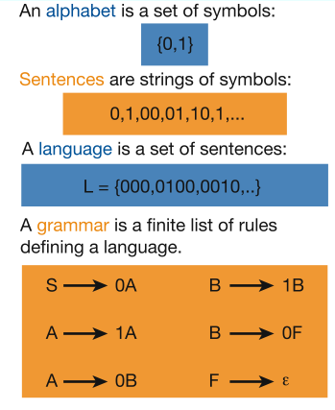
Languages & Grammars
Languages: “A language is a collection of sentences of finite length all constructed from a finite alphabet of symbols”
Grammars: “A grammar can be regarded as a device that enumerates the sentences of a language” - nothing more, nothing less
N. Chomsky, Information and Control, Vol 2, 1959
Or “words”
Image source: Nowak et al. Nature, vol 417, 2002

Slide 6
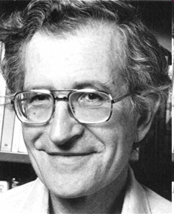
The Chomsky Hierachy
A containment hierarchy of classes of formal languages
Recursively- enumerable (TM)
Context- sensitive (LBA)
Context- free
(PDA)
Regular
(DFA)

Slide 7
The Central Concepts of Automata Theory

Slide 8
Alphabet
An alphabet is a finite, non-empty set of symbols
We use the symbol ∑ (sigma) to denote an alphabet
Examples:
Binary: ∑ = {0,1}
All lower case letters: ∑ = {a,b,c,..z}
Alphanumeric: ∑ = {a-z, A-Z, 0-9}
DNA molecule letters: ∑ = {a,c,g,t}
…

Slide 9
Strings
A string or word is a finite sequence of symbols chosen from ∑
Empty string is ε (or “epsilon”)
Length of a string w, denoted by “|w|”, is equal to the number of (non- ε) characters in the string
E.g., x = 010100 |x| = 6
x = 01 ε 0 ε 1 ε 00 ε |x| = ?
xy = concatentation of two strings x and y

Slide 10
Powers of an alphabet
Let ∑ be an alphabet.
∑^{k} = the set of all strings of length k
∑* = ∑⁰ U ∑¹ U ∑² U …
∑⁺ = ∑¹ U ∑² U ∑³ U …

Slide 11
Languages
L is a said to be a language over alphabet ∑, only if L ⊆ ∑*
➔ this is because ∑* is the set of all strings (of all possible length including 0) over the given alphabet ∑
Examples:
Let L be the language of all strings consisting of n 0’s followed by n 1’s: L = {ε, 01, 0011, 000111,…}
Let L be the language of all strings of with equal number of 0’s and 1’s:
L = {ε, 01, 10, 0011, 1100, 0101, 1010, 1001,…}
Definition: Ø denotes the Empty language
Let L = {ε}; Is L=Ø?
Canonical ordering of strings in the language
NO

Slide 12
The Membership Problem
Given a string w ∈∑*and a language L over ∑, decide whether or not w ∈L.
Example:
Let w = 100011
Q) Is w ∈ the language of strings with equal number of 0s and 1s?

Slide 13
Finite Automata
Some Applications
Software for designing and checking the behavior of digital circuits
Lexical analyzer of a typical compiler
Software for scanning large bodies of text (e.g., web pages) for pattern finding
Software for verifying systems of all types that have a finite number of states (e.g., stock market transaction, communication/network protocol)

Slide 14
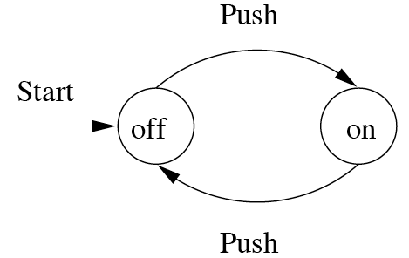
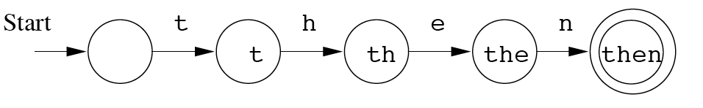
Finite Automata : Examples
action
On/Off switch
Modeling recognition of the word “then”
state
Start state
Transition
Intermediate state
Final state

Slide 15
Structural expressions
Grammars
Regular expressions
E.g., unix style to capture city names such as “Palo Alto CA”:
[A-Z][a-z]*([ ][A-Z][a-z]*)*[ ][A-Z][A-Z]
Start with a letter
A string of other letters (possibly empty)
Should end w/ 2-letter state code
Other space delimited words (part of city name)

